Slide 1
Multicultural Advisory Committee

Slide 2

Acknowledgement
We acknowledge the Traditional Owners of the lands on which we meet, the Wurundjeri Woi-wurrung and Bunurong/Boon Wurrung peoples of the Kulin Nation and pay our respects to Elders past and present.
We recognise Narrm as an ancient meeting place, where people have gathered to share knowledge, culture and community for countless generations.
As a city shaped by migration, Melbourne continues to bring together people from across the world. We celebrate this diversity while recognising that all who now call this place home do so on Aboriginal land, whose sovereignty was never ceded.

Slide 3
Information covered in the session
City of Melbourne – Quick facts​
About the Multicultural Advisory Committee​
Role of members​
Expression of Interest form​
Selection process and timeline​
Application assistance​
Questions​

Slide 4
About the City of Melbourne
189,000 residents​
55% of residents born overseas​
46% of residents speak another language than English at home​
24% of residents are students​
Median age of residents is 30years​
Over 60% of people rent their home​

Slide 5
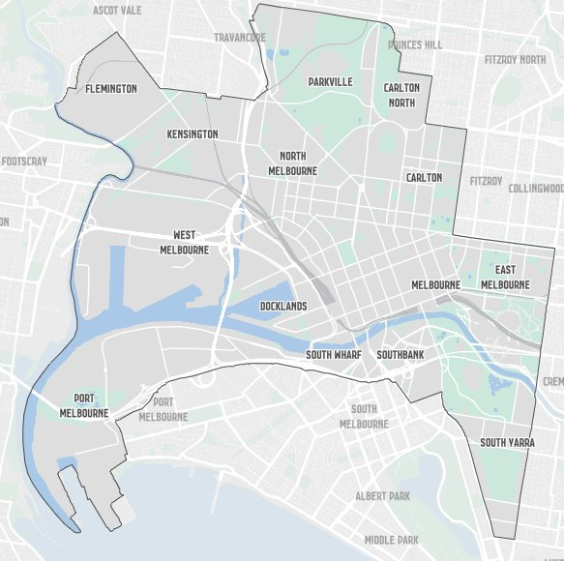
Map of City of Melbourne

Slide 6
Purpose of the committee
The purpose of the committee is to provide advice and community-informed insights to Council on multicultural issues, ensuring that policies, services, communications, and community engagement processes reflect the needs, aspirations, and lived experiences of Melbourne’s diverse multicultural communities.​

Slide 7
About the committee
The committee will be convened for an initial 12 months.​
Payment of $300 per meeting will be offered for members.​​
The meetings will be held during business hours
The meetings will be hybrid (you can attend in person or online)
4 meetings per year.​

Slide 8
About the committee continued
Membership​
Two Councillors ​​
12 external members​
At least one of these members will be a First Nations representative as per our Reconciliation Action Plan commitments.​
You must have a valid visa to be in the country until December 2027.

Slide 9
Role of members
Feedback​
Advice​
Practical recommendations​
Strategic guidance​
Connections to communities​
Advisory capacity only – no decision-making​

Slide 10
Expression of interest form
Complete via the Participate Melbourne site (or we can assist)​
You will need to answer questions:​
About yourself (demographics)​
About your connection to the City of Melbourne​
In response to the key selection criteria.​

Slide 11

Selection process
Assessment of Expressions of Interest, shortlisting and decision– may include interviews and/or reference checks (September-November)​
Recommended committee will be presented to Council (December)​
Council will endorse committee members​
All applicants will be notified of the outcome (mid-December)​

Slide 12
Application assistance
In language on the Participate Melbourne site​
Staff can book an interpreter to complete the expression of interest​
Other support please contact Kara​ Kara.barnett@melbourne.vic.gov.au​ or 0408 694 961​

Slide 13
Thank You

